Slide 1
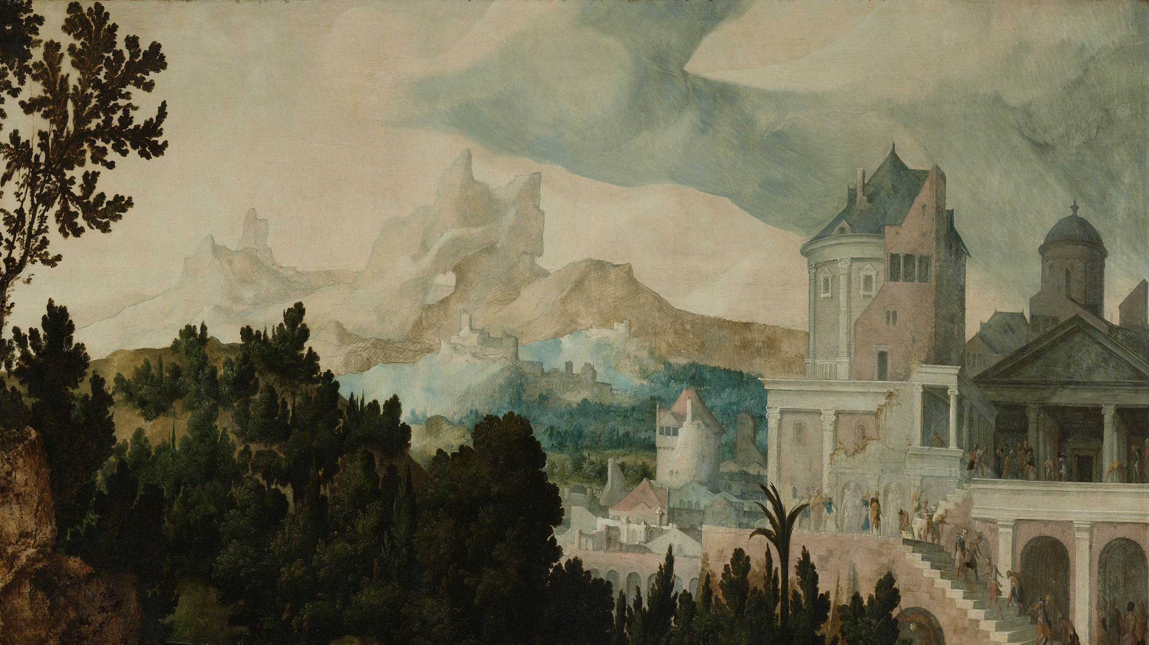
Beyond the Buzz:
What’s Really Going on with Data Usage in Digital Art History?
Sarah E. Seymore
Digital Collections Metadata Librarian
University of Oregon Libraries

Slide 2
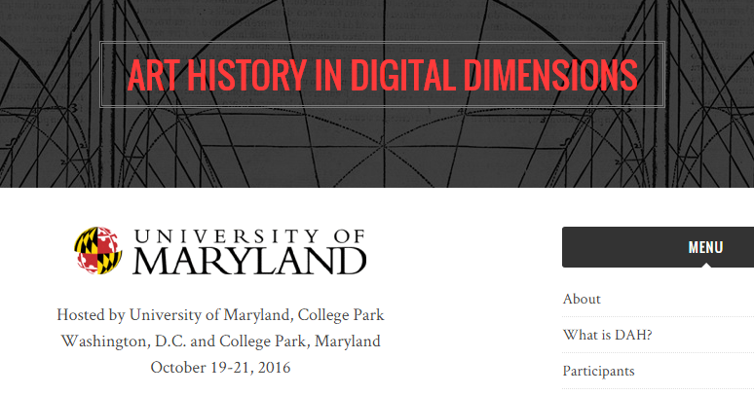
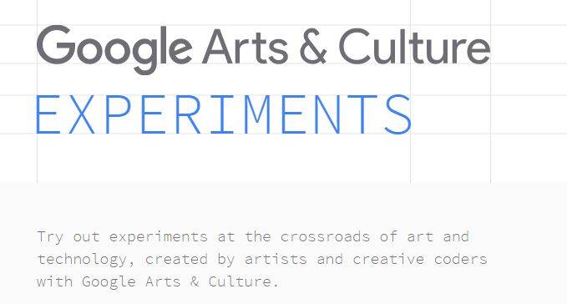
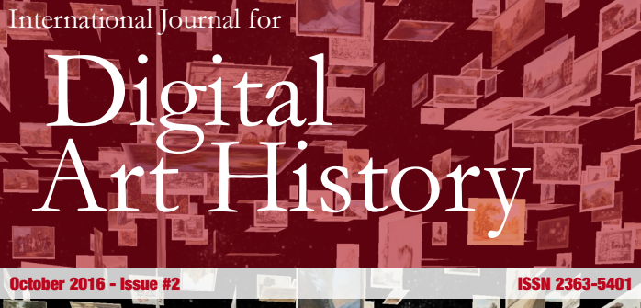
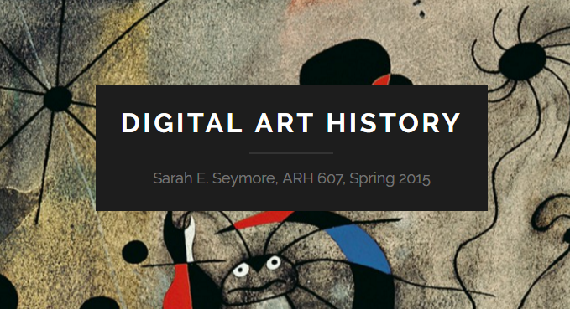


Slide 4

The audience
AAH (Association of Art Historians)
AAMD (Association of Art Museum Directors)
AAMG (Association of Academic Museums and Galleries)
AHNCA (Association of Historians of Nineteenth-Century Art)
ARLIS UK
ARLIS/NA
CAA (College Art Association)
LODLAM (Linked Open Data in Libraries, Archives, and Museums)
MCN (Museum Computer Network)
NMC (New Media Caucus)
OPEN GLAM (Galleries, Libraries, Archives, and Museums)
VRA (Visual Resources Association)

Slide 5
The questions
Which datasets are getting used?
What final form does the research take?
What is their profession?
What tools/programs are being used for data manipulation?
What is the preferred method for accessing and retrieving the data?
What is the preference for the format of the data?
What types of projects are being created?
What tools/programs are being used for data visualizations, data mining/text analysis, and online exhibitions?​

Slide 6
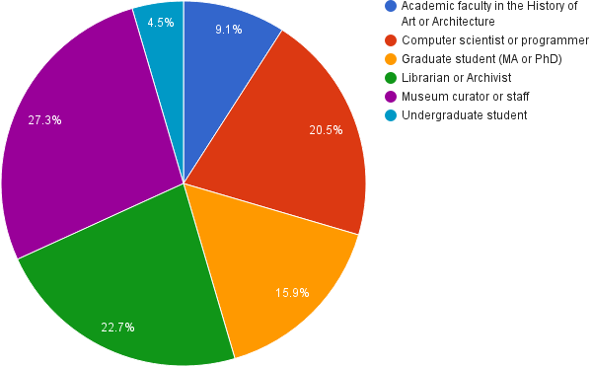
Academic faculty in Archaeology and Digital Humanities
Academic Faculty in Information Science
Archaeology/
Museum Studies
Government Research Director
Independent Art Historian
Metadata Specialist
What is your profession?

Slide 7
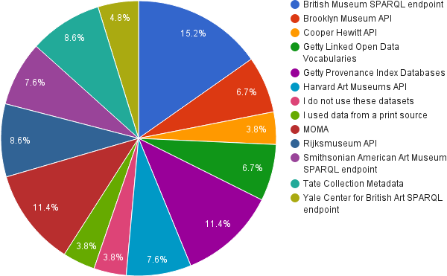
Have you used any of the following datasets in your research?

Slide 8
Other: Have you used any of the following datasets in your research?
Census data
Corpus of Romanesque Sculpture
DC
Europeana
Finna
Global Biodiversity Information Facility
HHI data
ICONCLASS
IMLS grant records
Metropolitan Museum of Art
National Gallery of Art
National Maritime Digital Library
NEH grant records
Nomisma.org
Norwegiana
NYPL API
Pierpont Morgan Corsair
Print source
Swedish Open Cultural Heritage
The Henry Ford
TROVE
Walters Art Gallery
Whaling Crew List Database
Wikidata
Wikimedia Commons

Slide 9
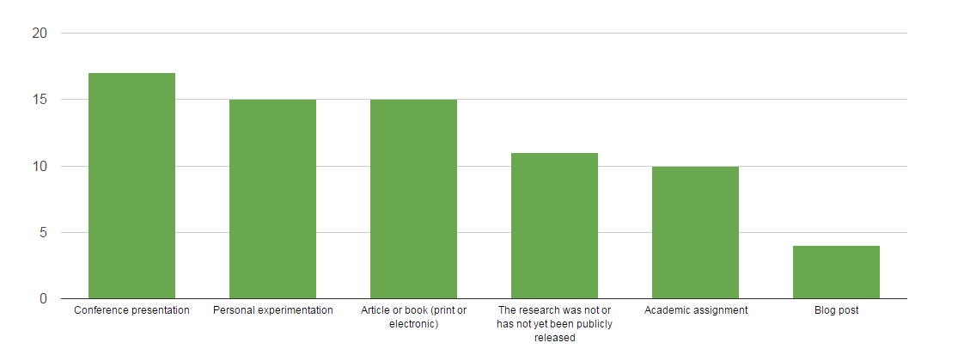
What final form did your research take?

Slide 10
Comments: What final form did your research take?
“I have been learning to use data visualization and manipulation tools by experimenting with these data sets.”
“I have used SPARQL endpoints like the BM one to explore the development of 'web termlists' for the Modes software, i.e. using the vocabularies within the BM system as live authorities for Modes data. I converted the Tate CSV data and re-published it as a Linked Data resource.”
“I have used the British Museum and Harvard APIs to extract data in order to transform into other data models for aggregation. This work has been the subject of presentations and papers.
“I totally failed with the British Museum SPARQL endpoint and am not doing much better with the Brooklyn Museum's API. I'm a slow learner. I wish I could just email someone and they could send me a csv.”
“More SPARQL, fewer bespoke APIs please..”

Slide 11
Other: What final form did your research take?
Corporate report
Exhibition
Gallery/exhibition labels
Linking to the Getty's vocabularies for our own YCBA's dataset
Online project for a local historical museum
Other data
Querying SAAM's dataset within the American Art Collaborative
Querying the British Museum and the Rijksmuseum datasets to test ResearchSpace
Querying the Harvard Museums API for IIIF purposes
Wikipedia
Working on harmonizing to the Getty Provenance Index data modeling
Good old fashioned written projects
Metadata enrichment
Scholarly articles and books
Wikipedia
Integration framework
Browse application
Interactive map of works on display
Crowd sourcing tools

Slide 12
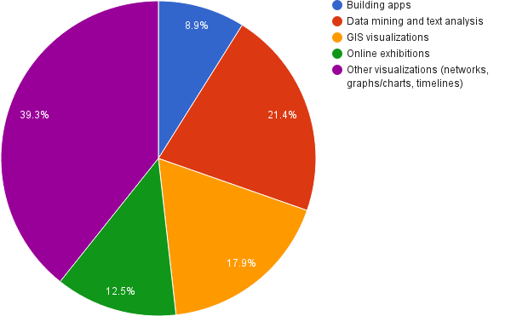
Good old fashioned written projects
Metadata enrichment
Scholarly articles and books
Wikipedia
Integration framework
Browse application
Interactive map of works on display
Crowd sourcing tools
What type of project are you creating?

Slide 13
Jordan Schnitzer Museum of Art Collections in Oregon Digital

Slide 14
Data Manipulation Experience*
How frequently do you use the following?
1: I don’t know what this is.
2: I don’t use this but I know what it is.
3: I have used it before.
4: I use this frequently for recent research.
5: I use this regularly for continuous research.
*These are for general data manipulation. Section 6, Type of Project, lists other resources that are linked with a type of project or platform.
Python: 2. I don’t use this but I know what it is.
R: 1. I don’t know what this is.
Excel: 5. I use this regularly for continuous research.
OpenRefine: 1. I don’t know what this is.
Xquery: 1. I don’t know what this is.
SPARQL: 1. I don’t know what this is.

Slide 15
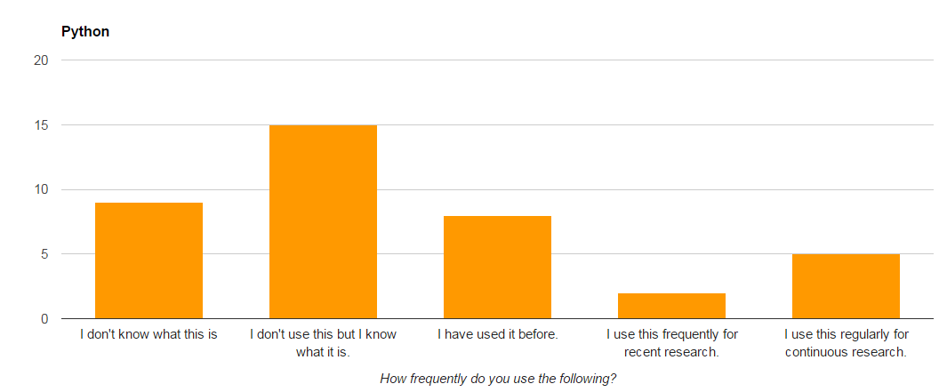

Slide 16
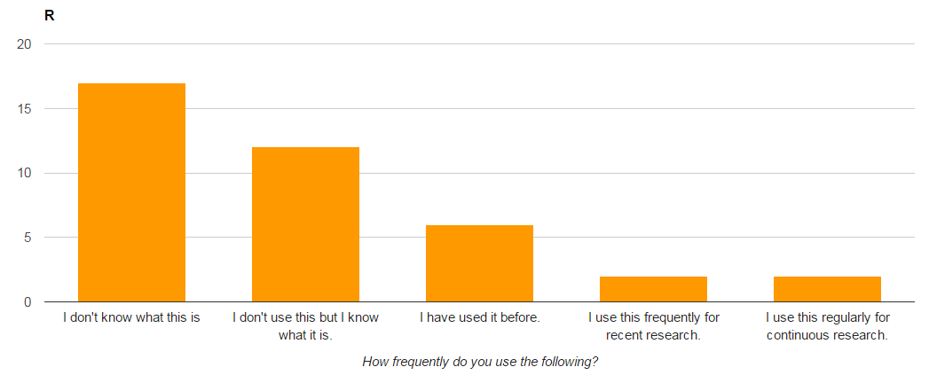

Slide 17
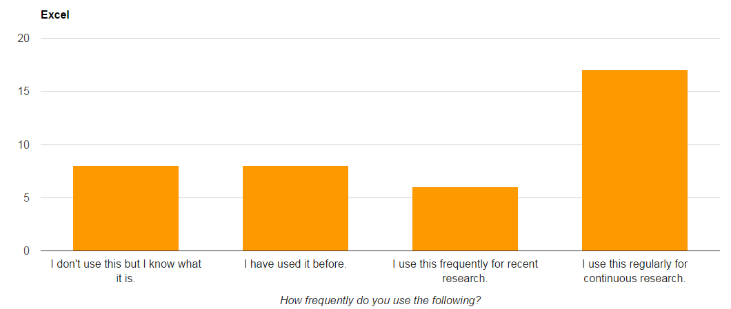

Slide 18
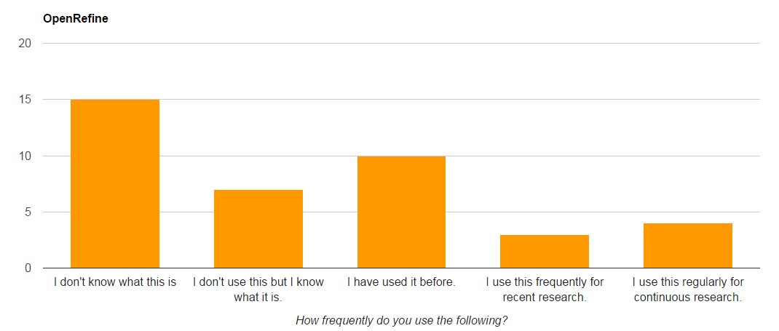

Slide 19
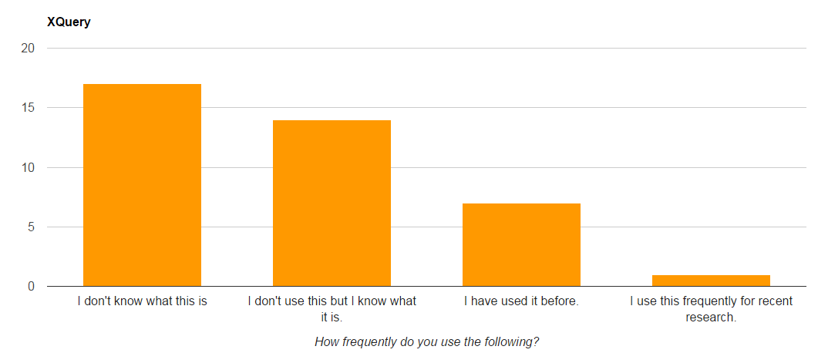

Slide 20
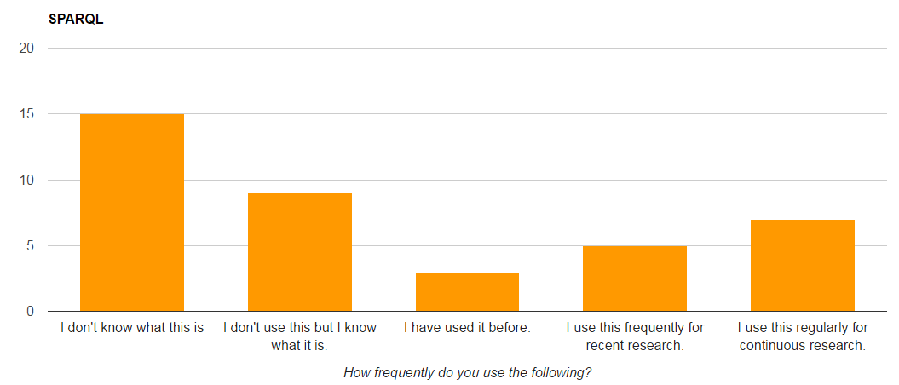

Slide 21
Data Manipulation Experience: By Profession / Top 3
Students: Excel, Python, Xquery
Librarians/Archivists: Excel, OpenRefine, Python
Computer scientists/programmers: SPARQL, Python, OpenRefine
Museum professionals: Excel, SPARQL, OpenRefine
Faculty/Art Historians: Excel, SPARQL, Python

Slide 22
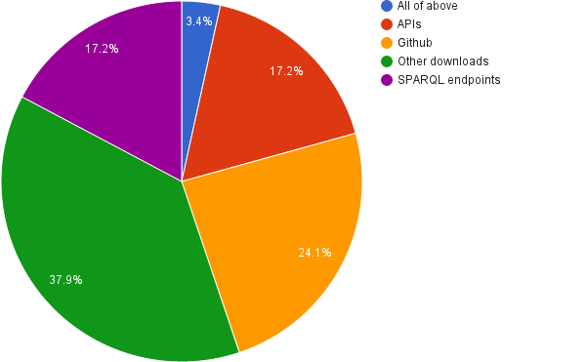
What is your preferred method for accessing and retrieving the data?

Slide 23
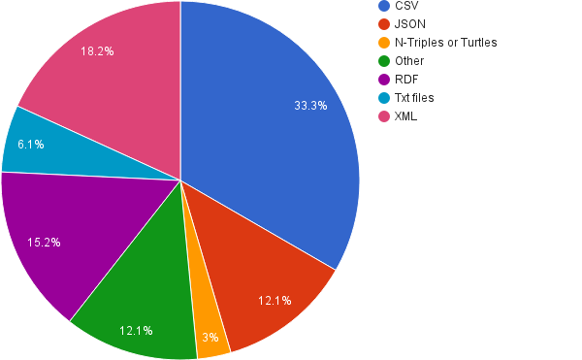
Any that get the data needed
No Preference
PDFs
XLS
What is your preference for the format of the data?

Slide 24
Comments: What is your preferred method for accessing and retrieving the data?
“ ’All of the above’ would have been a useful option. I'll work with whatever is available.”
“Both APIs and data dumps should be available, if only one option data dumps are to prefer.”
“It depends on the usage. I like Github to access all the data and then to treat them but I prefer the SPARQL as it can from the start to have data answering questions.”
“SPARQL can be so obnoxious. it would be nice to have a UI built on top of a SPARQL endpoint.”
“SPARQL is standard and the data have semantic meaning. APIs rarely expose semantically meaningful data.”
“SPARQL, for all its faults, is at least a standard access mechanism with a well-defined query syntax. Data can be queried 'where it lies', which is preferable to having to carry out a download/reformatting exercise on every piece of data.”
“…Bespoke APIs are a pain.”

Slide 25
Comments: What is your preference for the format of the data?
“I don't really have a preference. It depends on what I 'm trying to do; I like SPARQL and RDF for ease-of-use.”
“I prefer to read and write Turtle, but use RDF/XML for processing”
“It depends on the usage.”
“JSON is structured and a common data format. easy to transform to csv for import.”
“Much cultural heritage information is semi-structured, involving textual content. None of the other formats begins to cope with this.”
“RDF is the best format to express the complexity of cultural heritage data.”

Slide 26
Students: Downloads; XML
Librarians/Archivists: Github; CSV
Computer scientists/programmers: SPARQL endpoints; tie b/t JSON and CSV
Museum professionals: Downloads; tie b/t CSV and XML
Faculty/Art Historians: Nothing conclusive –all over the place
Accessing and retrieving the data / Format of the data: By profession

Slide 27
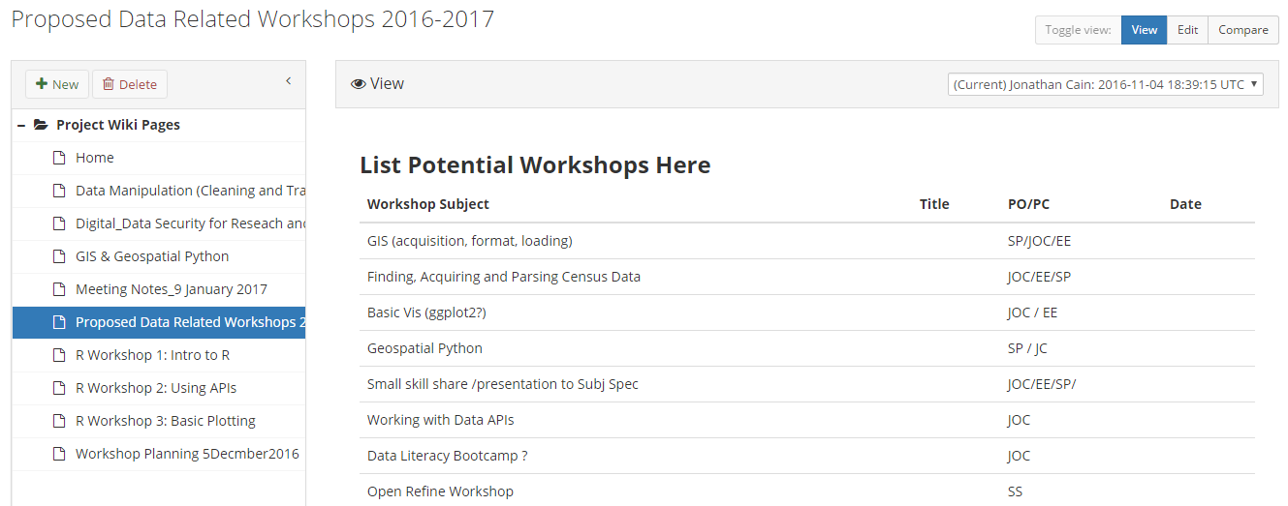
“Train the trainer” workshops

Slide 28
Other Comments
“…I am interested in the philosophy and principles of open access and Linked Open Data, but I do not use the data sets as such, I am simply an academic/curator user at the front end, but not at the back end.”
“…I would like to make our data readily available for research so knowing more about the types of analysis that people are currently undertake as well as the types of analyses that they would like to undertake would be very useful…”
“We use the semantic framework of the CIDOC-CRM to express the complexity of our collections data in a RDF format. RDF alone is not enough to do that so it is critical for museums to take advantage of the CIDOC CRM to appropriately represent their knowledge in the Semantic Web. I guess we are still in a phase of LOD now where most institutions produce RDF but have not quite developed applications that consume RDF well yet…”
“I'm interested in museums (etc.) using standard Linked Data authorities, so as to facilitate genuine interoperability at the data level. That, of course, requires that such authorities exist, which is another of my challenges ...”
“no specific project, just experiments”

Slide 29
Conclusions: The landscape and the problems
LOD projects will continue to develop and skills to work with these types of data are needed
A lot of projects are data enrichment, aggregation, and enhancement
Varying levels of technical expertise and preferences for data formats and retrieval
This interest in opening up data is not going away
What does this mean for librarians? How can we increase collaboration for data sharing and expertise in DAH?

Slide 30
Conclusions: Some solutions
Let us do the data cleanup and sharing for you!
We have a lot of data skills already
We are already heavily-relied upon collaborators in DH and DS
Mediators and advocates for an iterative data cycle of use and reuse

Slide 31



Thank you!
And special thanks to Dan Lipcan and the ARLIS/NA Mentoring Program!
@SarahESeymore
sseymore@uoregon.edu
@sseymore
Image detail: Jan van Scorel, Landscape with Bathsheba, Utrecht, c. 1540 - c. 1545', in J.P. Filedt Kok (ed.), Early Netherlandish Paintings in the Rijksmuseum, online coll. cat. Amsterdam 2009: hdl.handle.net/10934/RM0001.COLLECT.5443

